Slide 1
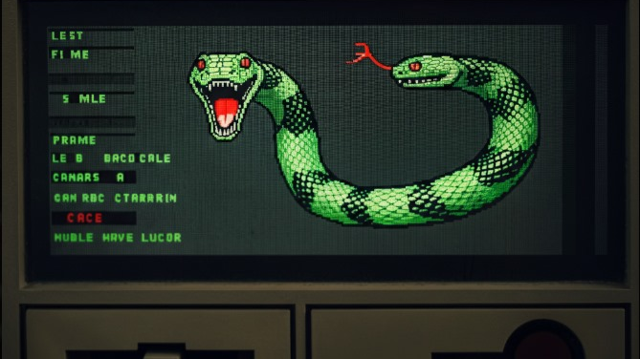
SNAKE GAME
Presented by :
MUBASHIR SHAHWEZ (160124749052)
SYED FAIZ AHMED BASHA (160124749056)
RACHIT KISHORE (160124749054)
NIKHIL JUTTUKONDA(160124749053)

Slide 2

INTRODUCTION
What is Snake ?
A classic arcade game where you control a snake that grows longer as it eats food.
The goal is to avoid hitting the walls or yourself while trying to achieve the highest score possible.
Our Project:
A C program that recreates this iconic game in a console window.
Uses basic C functions and libraries to handle graphics, input, and game logic.

Slide 3
HOW TO PLAY?
Controls:
W: Move Up
A: Move Left
S: Move Down
D: Move Right
X: Exit Game
Gameplay:
Use the controls to guide the snake towards the fruit (*).
Each time the snake eats the fruit, it grows longer and you score a point.
Avoid hitting the walls (#) or the snake's own body.
Game Over if you collide!

Slide 4
GAME DESCRIPTION
This is a classic Snake game implemented in C!
How to Play:
Control the snake: Use the 'w' (up), 's' (down), 'a' (left), and 'd' (right) keys to change the snake's direction.
Eat the fruit: Guide the snake to eat the fruit (*) that appears randomly on the board.
Grow longer: Each time the snake eats a fruit, its length increases and your score goes up.
Avoid collisions: Don't run into the walls or into yourself! The game ends if you collide.

Slide 5
Features:
Simple and easy-to-understand code.
Classic snake gameplay.
Score tracking.
Game over condition.
This game provides a fun and interactive way to experience the classic Snake game while learning about basic C programming concepts like arrays, loops, functions, and input handling.

Slide 6
PROGRAM DESCRIPTION
Headers:
stdio.h: For input/output operations (like printing to the console).
stdlib.h: For general utilities (random numbers, system commands).
conio.h: For console input/output (reading key presses).
time.h: For seeding the random number generator.
Core Components:
Game Area: Defined by WIDTH and HEIGHT (20x10 in this case).
Snake: Represented by snake X[] and snakeY[] arrays, storing coordinates of each segment.
Fruit: Located at fruitX and fruitY.
Direction: Indicates where the snake is moving (0: Right, 1: Up, 2: Left, 3: Down).
* *Score:* Tracks the player's progress.

Slide 7
KEY FUNCTIONS
randRange(): Generates random numbers for fruit placement.
placeFruit(): Positions the fruit randomly within the game area.
initializeGame(): Sets up the initial game state (snake, fruit, score).
updateGame(): Handles snake movement, collision detection, and fruit consumption.
drawGame(): Draws the game elements (borders, snake, fruit) and displays the score.

Slide 8
GAME LOOP
1. Initialization:
Seed the random number generator (srand(time(NULL))).
Initialize the game (initializeGame()).
2. Game Loop (while (1)):
Draw: Display the game on the console (drawGame()).
Input: Check for player input and change direction accordingly.
Update: Update the game state (updateGame()).
Delay: Introduce a small delay to control game speed (usleep())

Slide 9
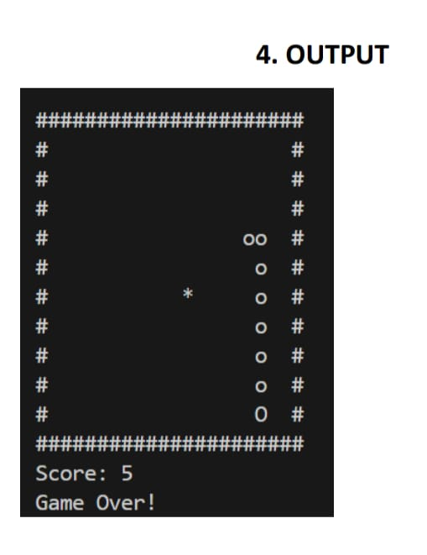
OUTPUT

Slide 10
CONCLUSION
This project demonstrates how to create a simple yet engaging game using C programming.
It covers fundamental concepts like game loops, user input, and basic graphics rendering in a console environment.
This foundation can be expanded to create more complex games with advanced features.
Thank you!

